Slide 1
Verilog Open Source Ethernet MAC
Jake Mercer

Slide 2

Fundamentals
ALOHA
Packet-based radio networks
Multiple Access Shared Medium
Random Access
Collision Detection
Ethernet
Packet-based wired networks
Multiple Access Shared Medium
Carrier Sense
Collision Detection
Notes:
Ethernet is ubiquitous in the telecoms world. It’s in your home networks, business networks, even in your car. It’s one of the most widely adopted technologies ever and is rapidly progressing.
1973 is where it all started. Bob Metcalfe of Xerox PARC was inspired by the earlier ALOHA network and came up with Ethernet.
Aloha used a simple setup where any radio could transmit at any time, and an acknowledgement was sent on reception of a message. If the transmitting station did not receive an acknowledgement, it was assumed that multiple stations had attempted transmission and a collision had occurred. Upon detection of a collision, transmitting stations backed off for a random amount of time before retrying. With increased traffic came an increased number of collisions, resulting in a maximum channel utilisation of around 18%.
Ethernet improved upon Aloha by having each station listen to the channel before trying to transmit, this massively reduced the number of collisions and made it easier for multiple stations to share a channel, this formed the Carrier Sense Multiple Access (CSMA) protocol, which was further improved by adding Collision Detection (CD), as in Aloha albeit implemented differently. You will often see this mentioned as CSMA/CD. The backoff algorithm was also improved upon, putting Ethernet well ahead of any networking technology of the time.
Metcalfe saw the importance of interconnectivity of devices and was a forward-thinking individual. He convinced Xerox to release Ethernet to the world as an open standard, allowing anyone to copy and use it, and formed a consortium of vendors to manage the standard, eventually being adopted by the IEEE and recognised as an ISO standard.

Slide 3
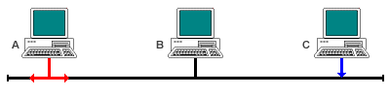
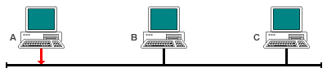
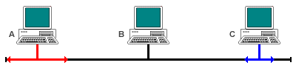
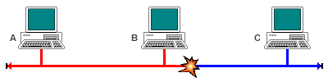
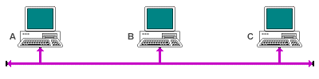
Fundamentals
Notes:
In terms of the physical technology, Ethernet was originally run over coaxial cabling, with a bus topology. Stations connected to the network via taps into the coax and shared the medium. This came with issues: if the backbone of the network was damaged, connectivity was lost and finding the fault was difficult. With the advent of twisted pair, it became possible for the network topology to change from bus to star, making for a much less painful installation process. Most Ethernet installations today still use the twisted pair technology and advancements have been made in using fibre optics to carry Ethernet as well. Using this diagram, I’ll show you how Ethernet worked originally, and still does for half duplex modes.
- Station A senses a free medium and starts transmitting.
- Station C senses a free medium and transmits as well because the signal from A hasn’t reached it yet.
- The packets collide
- The stations detect the collision.

Slide 4
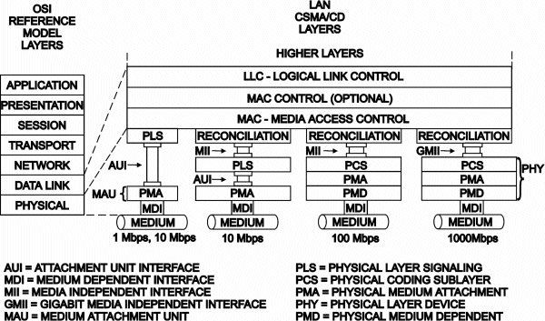
Fundamentals
Notes:
In order to perform the CSMA/CD operations and send a packet, the concept of the Media Access Controller (MAC) sublayer was created. The job of the MAC is to listen to the media, acquire the media, transmit or receive Ethernet packets, and detect errors, along with a few other functions, such as recording the number of packets it has received. The MAC as it sits relevant to the OSI mode is shown here. -> Expand

Slide 5
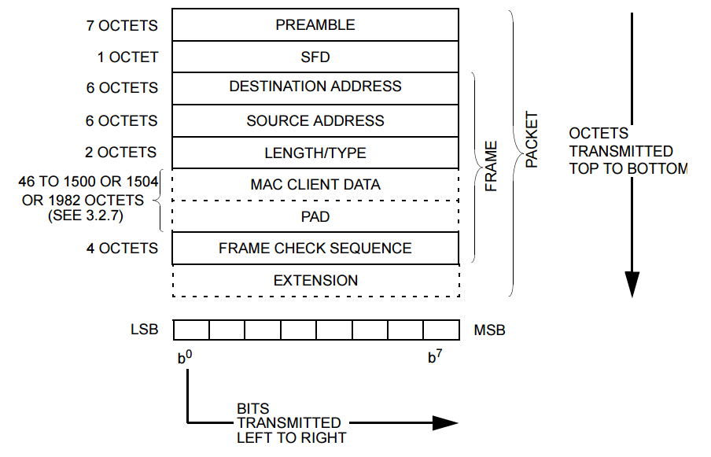
Fundamentals

Slide 6
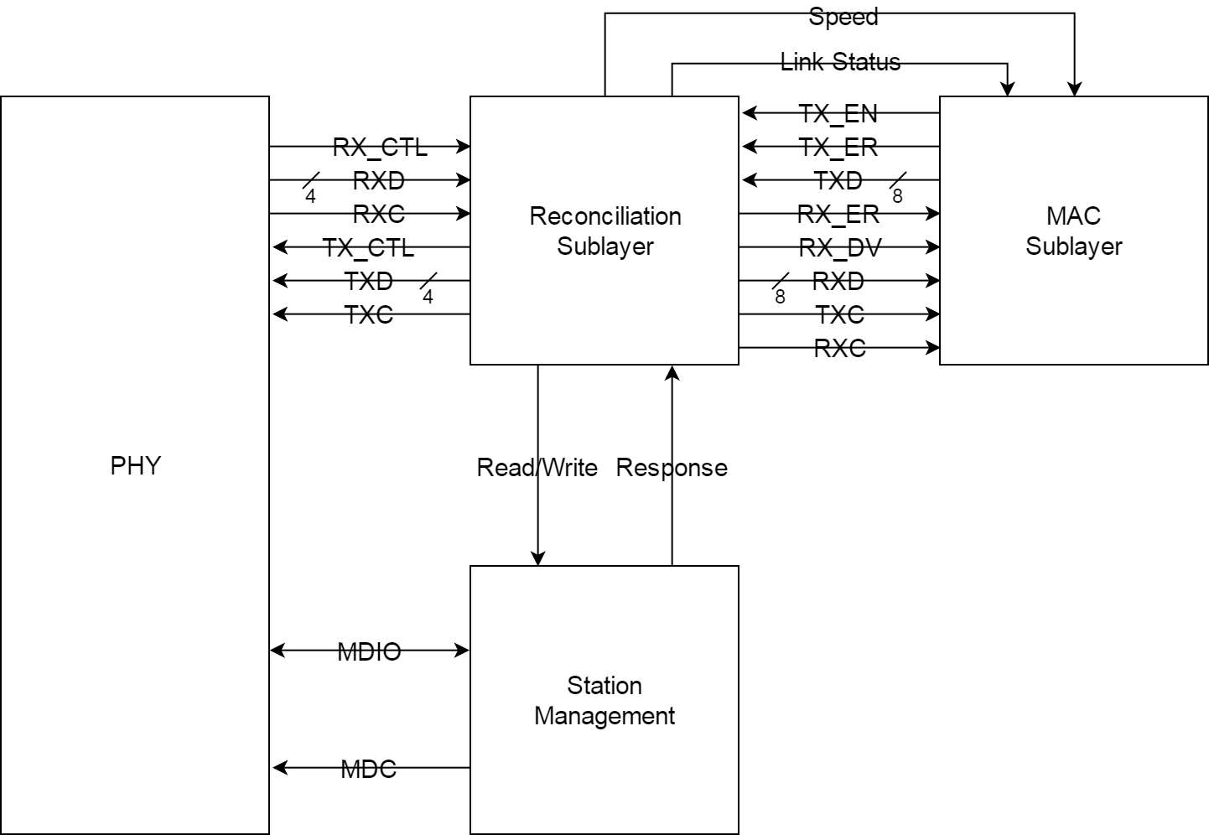
Design
Notes:
Overall diagram

Slide 7
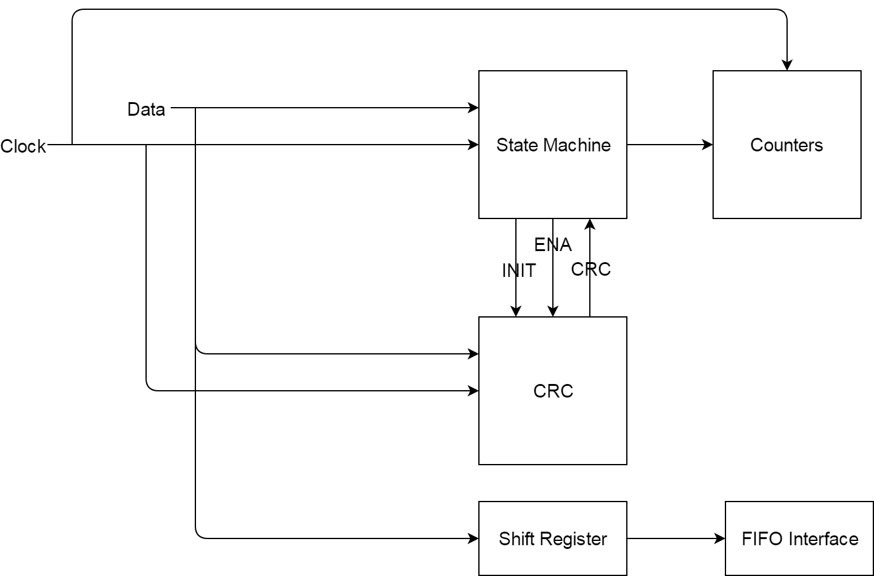
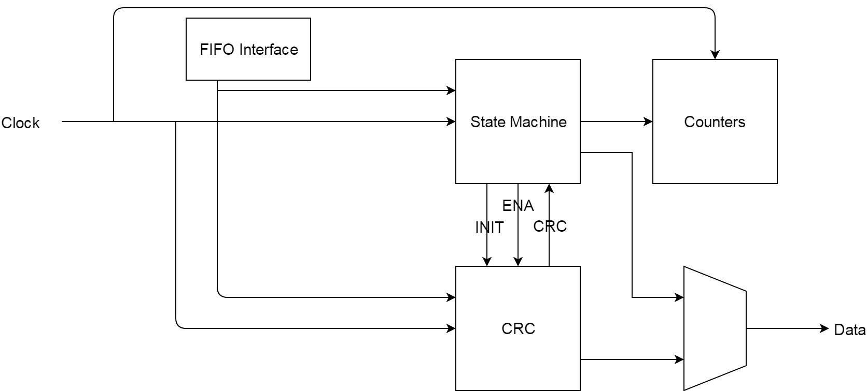
Design
Notes:
Rx Left
Tx Right

Slide 8
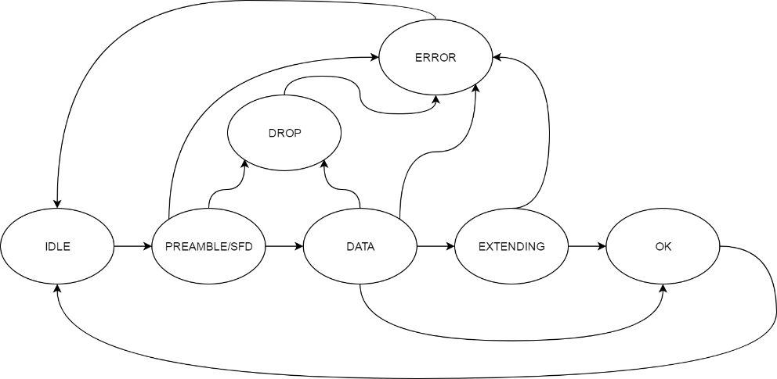
Design
Receive State Machine
IDLE
PREAMBLE
DATA
EXTEND
OK
DROP
ERROR

Slide 9
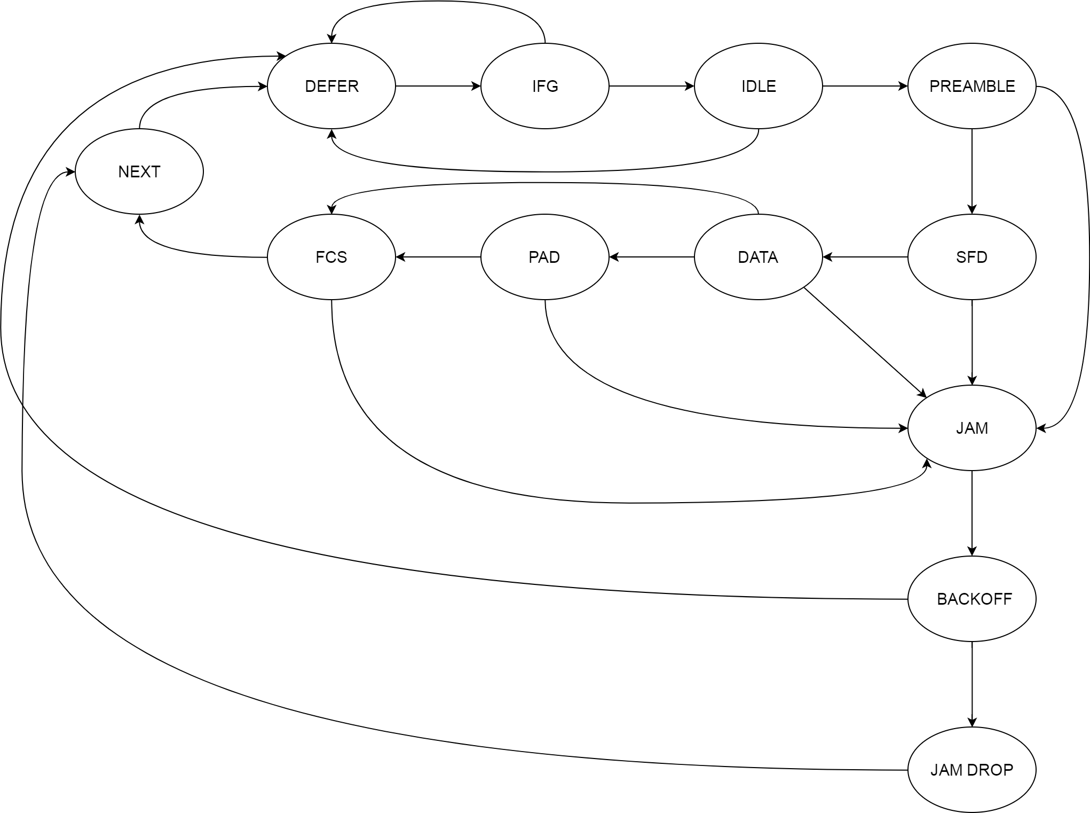
Design
FCS
JAM
JAM DROP
BACKOFF
NEXT
Transmit State Machine
DEFER
IFG
IDLE
PREAMBLE
SFD
DATA
PAD

Slide 10
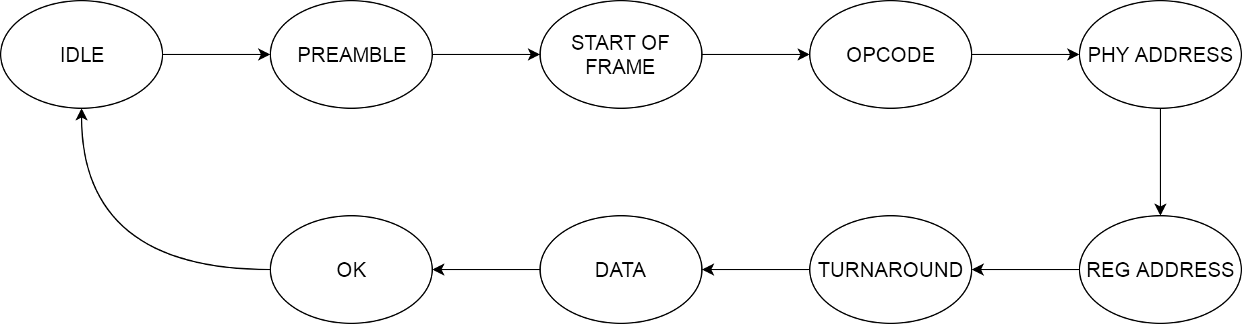
Design
Station Management State Machine
IDLE
PREAMBLE
START OF FRAME
OPCODE
PHY ADDRESS
REG ADDRESS
TURNAROUND
DATA
OK

Slide 11
Design
Reconciliation Sublayer
10/100 - MII
10/100 - RMII
10/100/1000 - GMII
10/100/1000 - RGMII
Notes:
Multiple MIIs implemented, RGMII in use

Slide 12
Implementation
Resource | Utilization | Available | Utilization %
LUT | 360 | 203800 | 0.18
LUTRAM | 2 | 64000 | 0.01
FF | 248 | 407600 | 0.06
BRAM | 0.50 | 445 | 0.11
IO | 15 | 400 | 3.75
BUFG | 4 | 32 | 12.50
MMCM | 2 | 10 | 20.00

Slide 13
Implementation
Hold
Worst Hold Slack | 0.088 ns
Total Hold Slack | 0.000 ns
Number of Failing Endpoints | 0
Total Number of Endpoints | 501
Setup
Worst Negative Slack | 0.037 ns
Total Negative Slack | 0.000 ns
Number of Failing Endpoints | 0
Total Number of Endpoints | 501
Pulse Width
Worst Pulse Width Slack | 1.100 ns
Total Pulse Width Slack | 0.000 ns
Number of Failing Endpoints | 0
Total Number of Endpoints | 274
Notes:
Worst Negative Slack is close

Slide 14
Comparison
Xilinx Tri-Mode Ethernet MAC
LUTs | FFs | DSP48s | 36k BRAMs | 18k BRAMs
978 | 1526 | 0 | 0 | 0
LUTs | FFs | DSP48s | 36k BRAMs | 18k BRAMs
1484 | 2516 | 0 | 0 | 0
Open Cores Tri-Mode Ethernet MAC
LUTs | FFs | DSP48s | 36k BRAMs | 18k BRAMs
1526 | 1198 | 0 | 0 | 4
Notes:
Low relative utilisation to these. Less features, but that’s ok

Slide 15
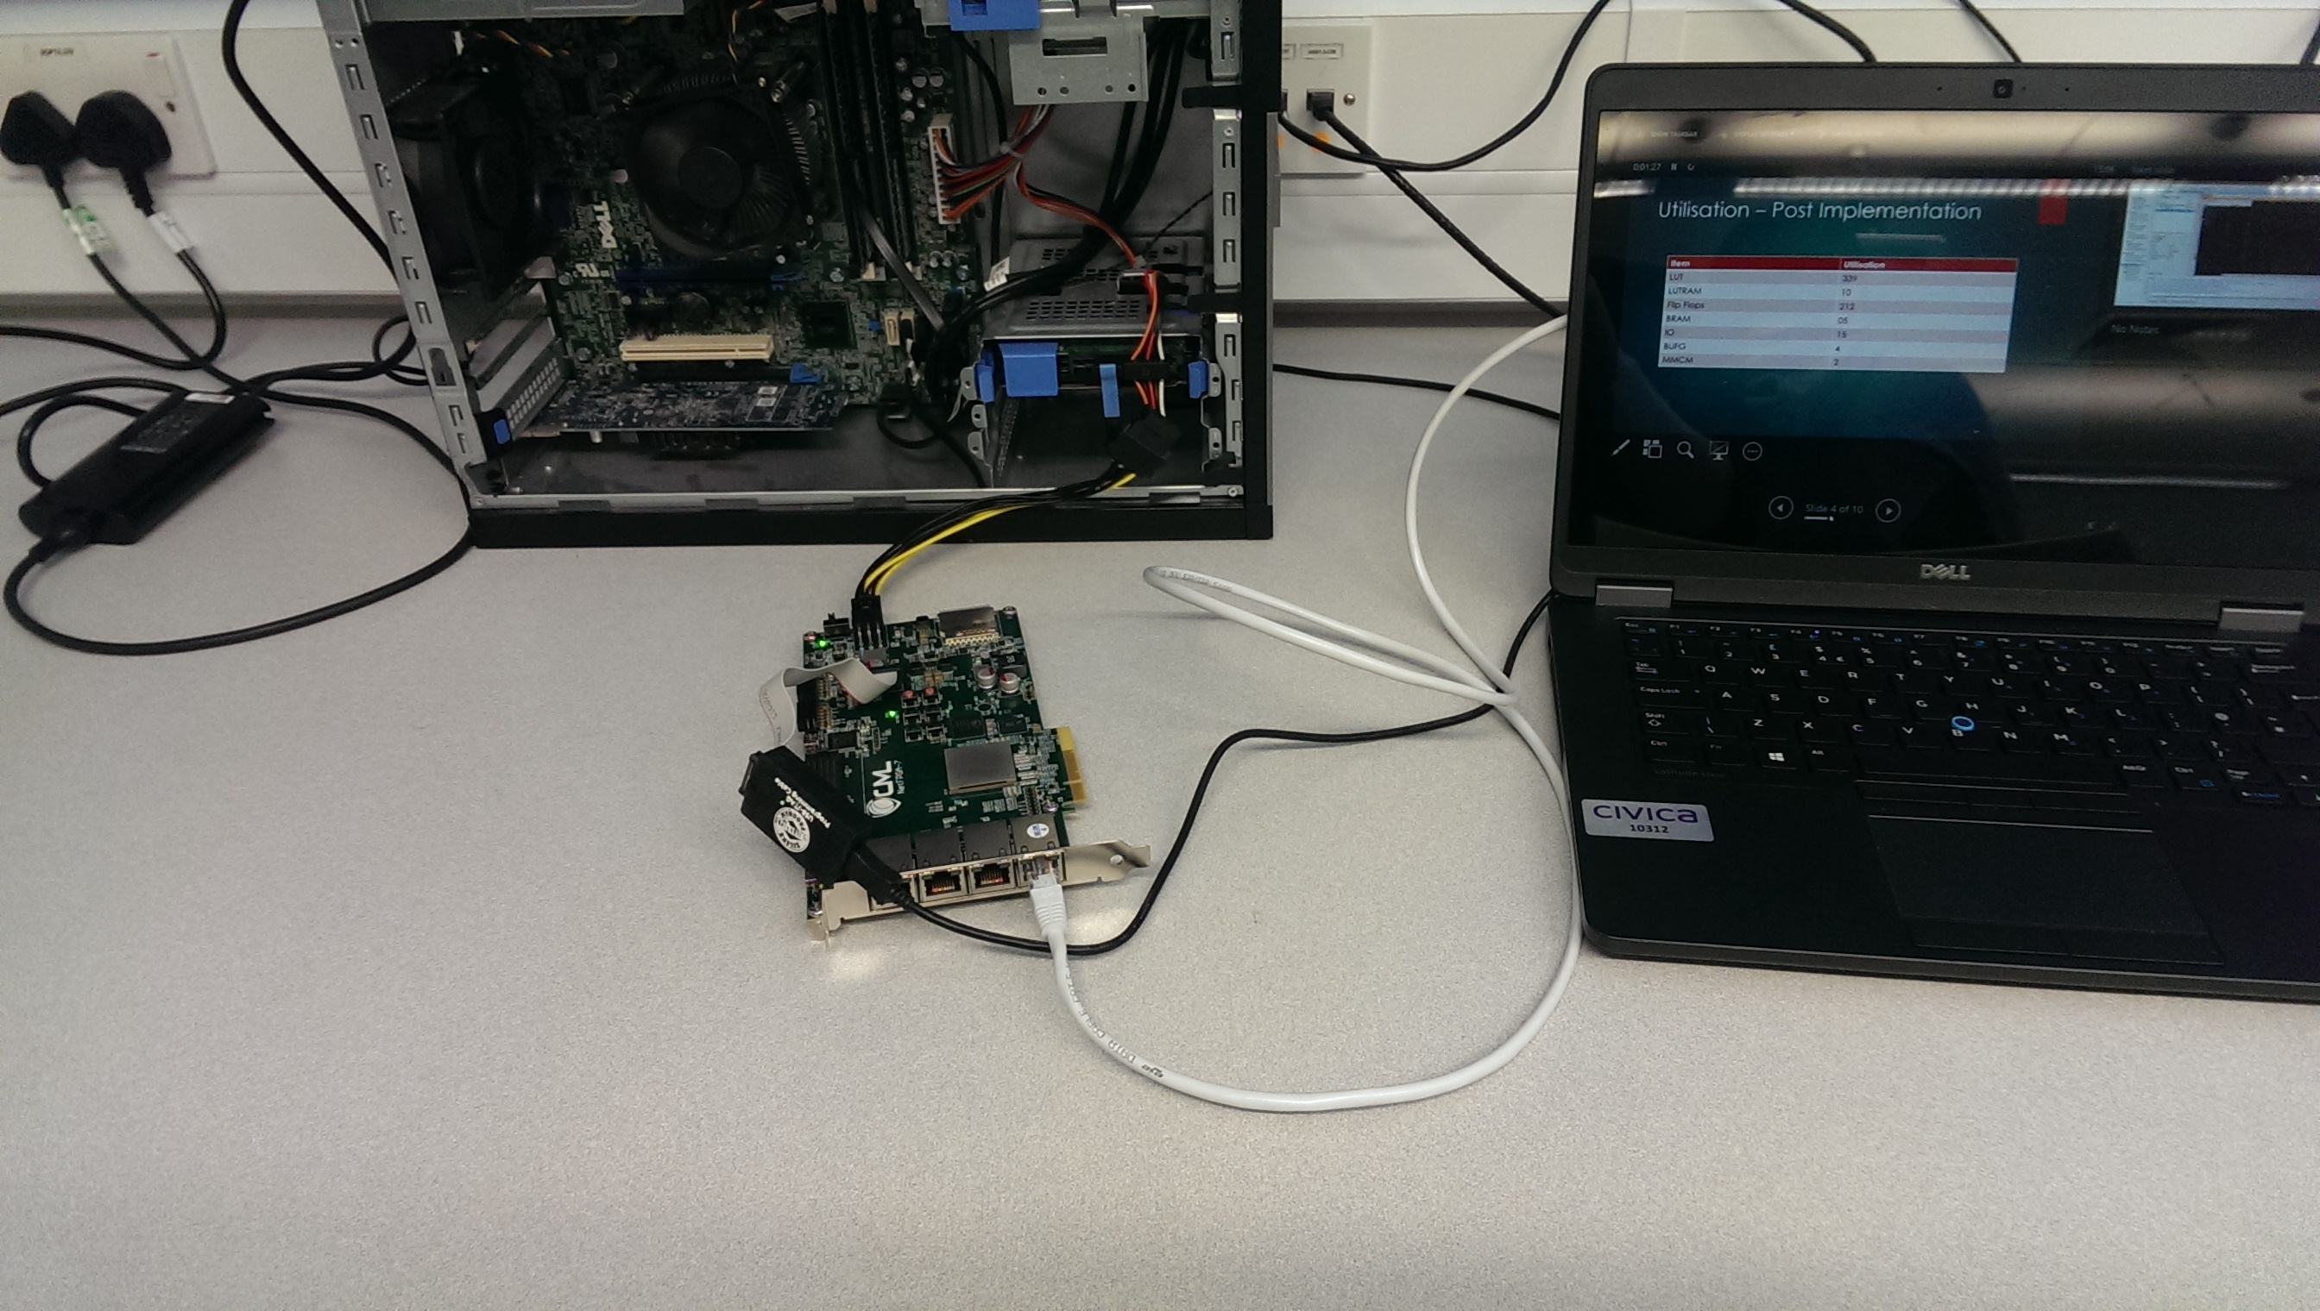
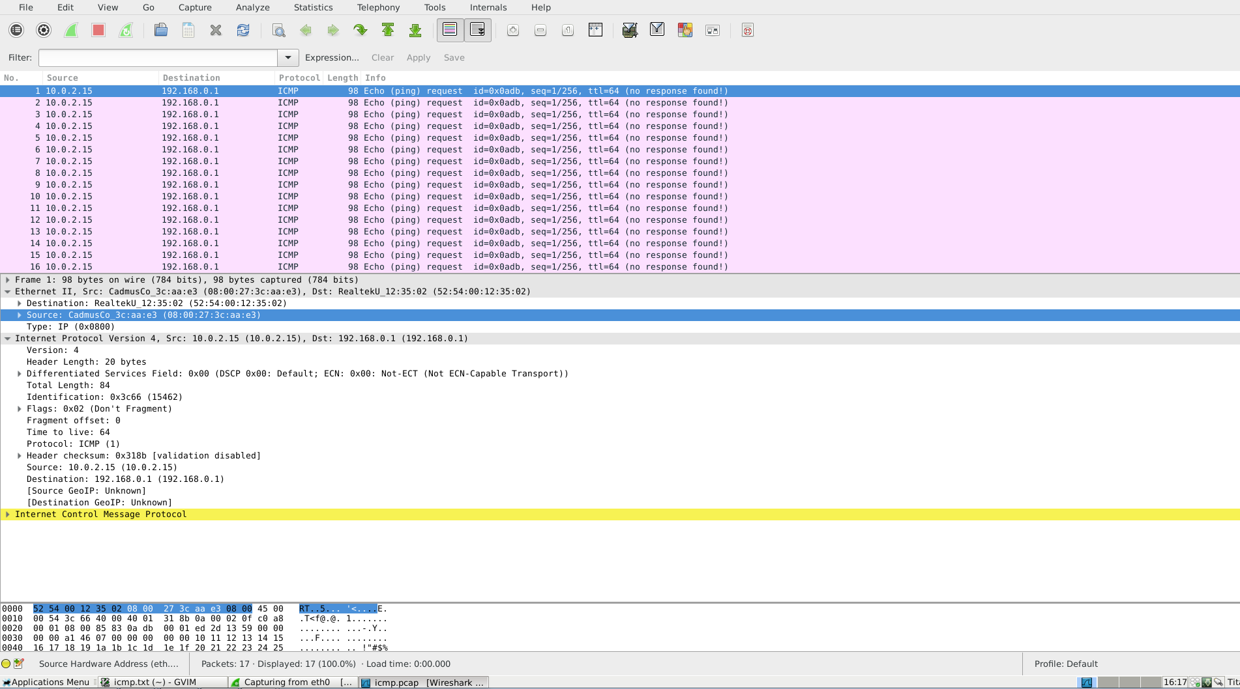
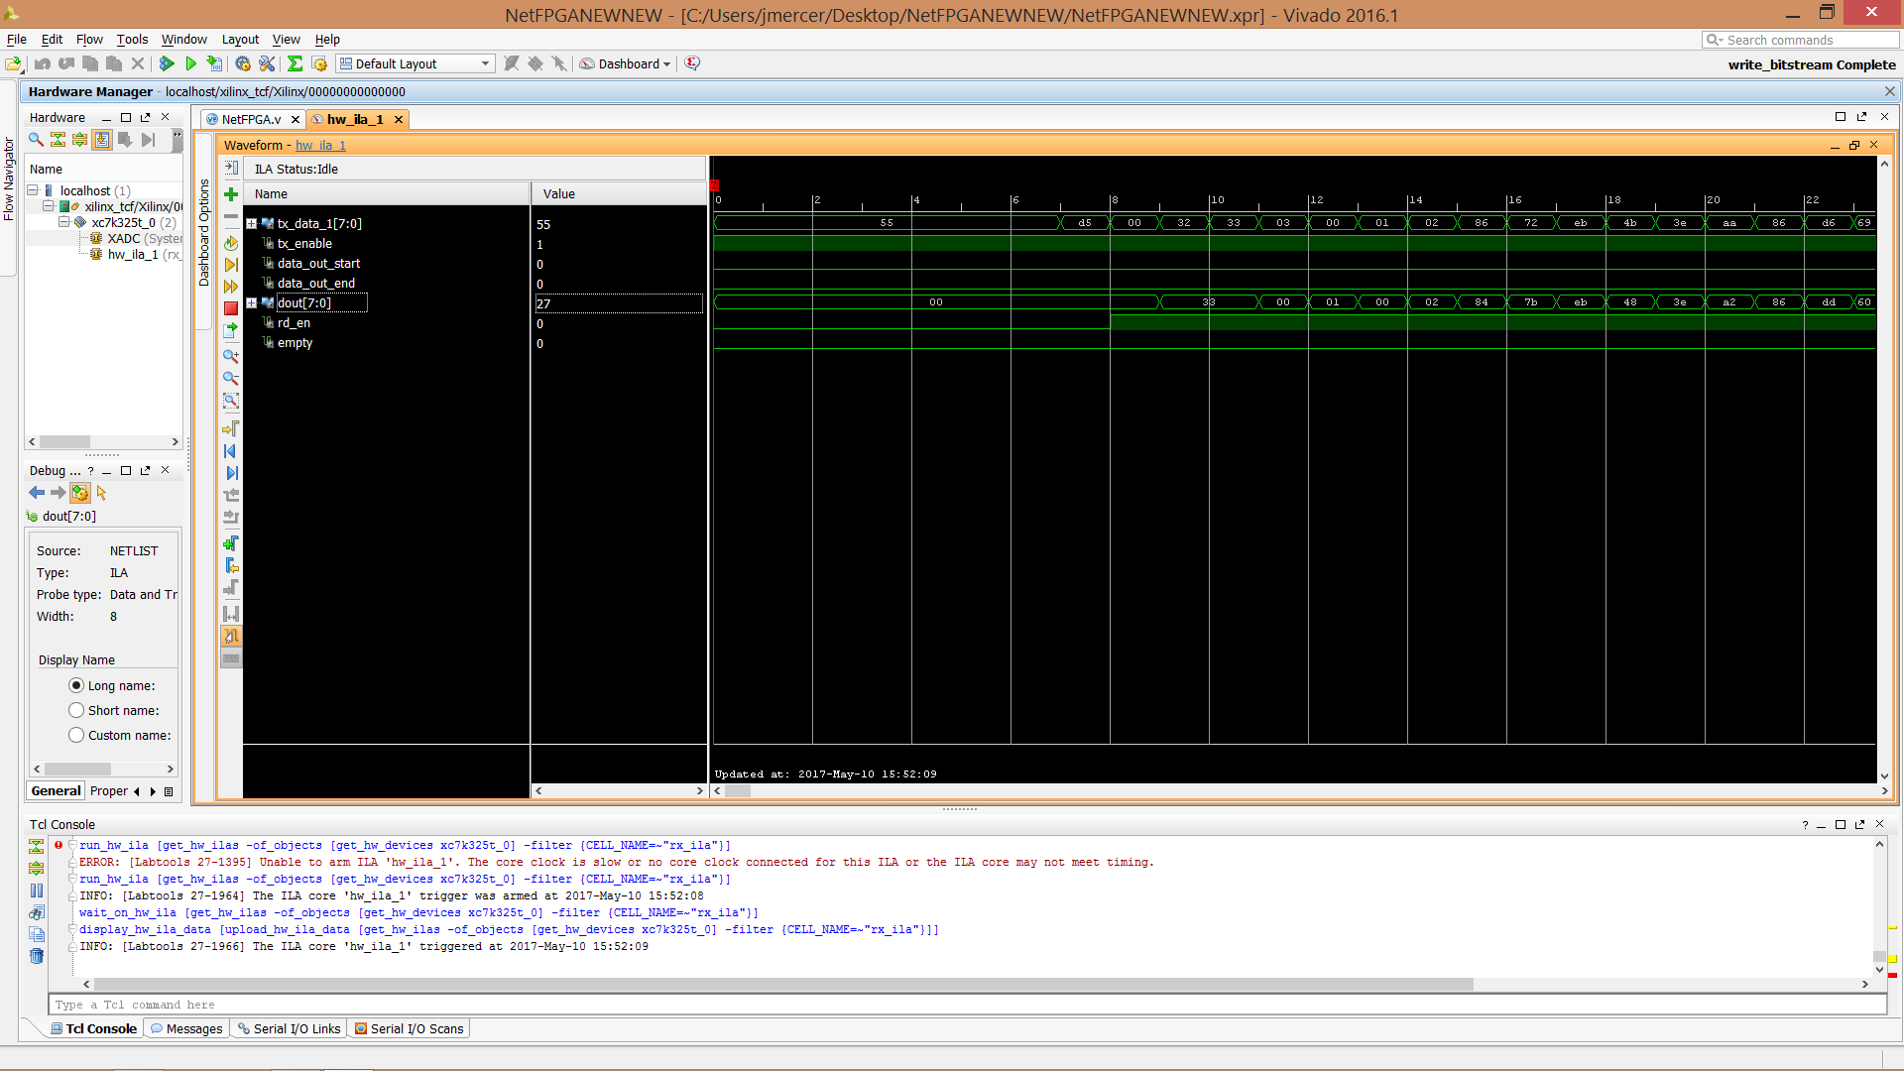
Testing
Test Benches
Integrated Logic Analyser
Spirent Test Centre
Notes:
Automating test benches
Loopback mode

Slide 16
Future
Improve timing
Merge into NetFPGA project
Carrier Extension & Packet Bursting
Packet Generation & Shaping
Packet Capture
Ethernet Test Modules
EOAM
MPLS
ARP

Slide 17
Timeline
Date | Notes
1st March 2017 | MAC design started.
5th March 2017 | Rudimentary design completed. Verilog coding begins.
9th March 2017 | Backoff module development is complete and the core is simulated and passing the tests.
20th March 2017 | CRC module is complete and simulated.
27th March 2017 | Transmit module is complete and simulated.
5th April 2017 | Receive module is complete and simulated.
7th April 2017 | MII module is complete and simulated.
8th April 2017 | RMII module is complete and simulated.
9th April 2017 | GMII module is complete and simulated.
10th April 2017 | RGMII module is complete and simulated.
14th April 2017 | Constraints set up for Kintex-7.
20th April 2017 | Design connected with Xilinx IP instantiated.
24th April 2017 | Tested with ILA.
25th April 2017 | Loopback testing in DS lab started.
3rd May 2017 | Project expo.
Notes:
8 week cycle

Slide 18
Questions?

